Slide 1
Library Data Dashboard Documentation
Presented by James Ocampo
Mentored by Tammy Parrott (Library Services Manager)

Slide 2
Overview
How to add new Fiscal Years?
How to add a new Library Branch?
How to Grant Access to View the Dashboard?
How to Manually Update the Dashboard?
Limitations

Slide 3
How to add new Fiscal Years?

Slide 4
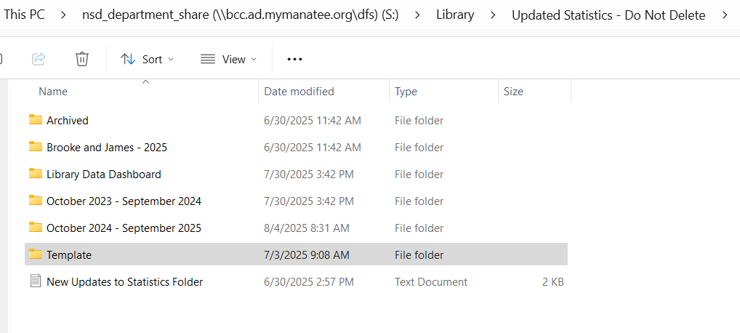
How to add new Fiscal Years?
Select and Copy (Ctrl+C) the “Template” Folder in the
“Updated Statistics – Do Not Delete Folder”

Slide 5
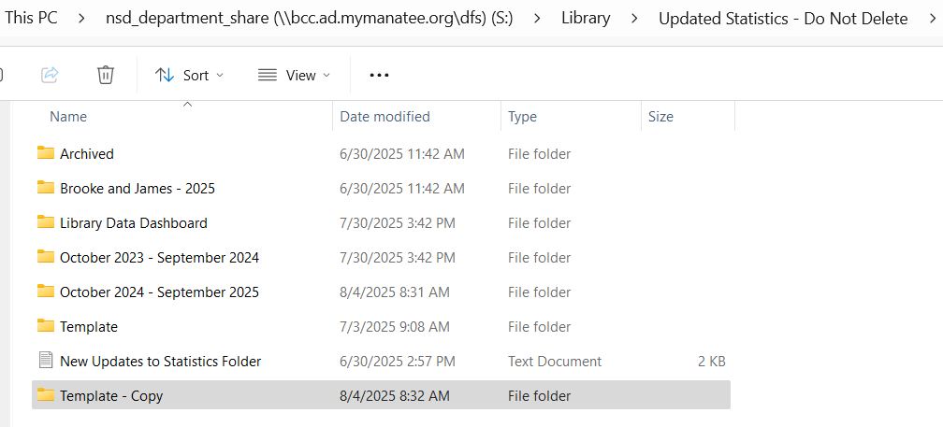
How to add new Fiscal Years?
Paste Copy (Ctrl+V) the “Template” Folder

Slide 6
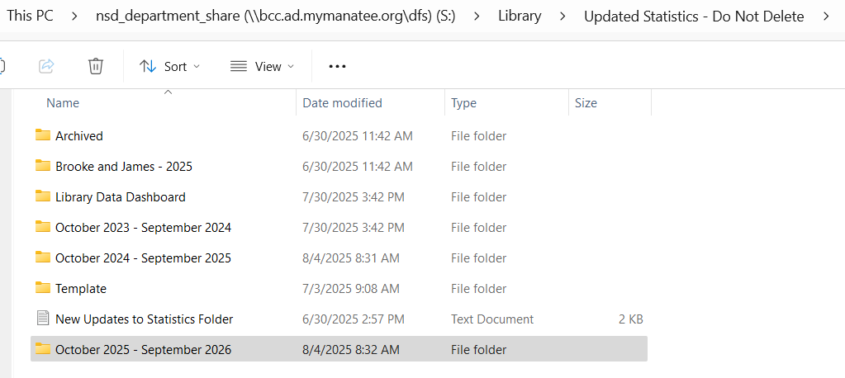
How to add new Fiscal Years?
Rename the “Template - Copy” Folder to this format: “October 20__ - September 20__”

Slide 7
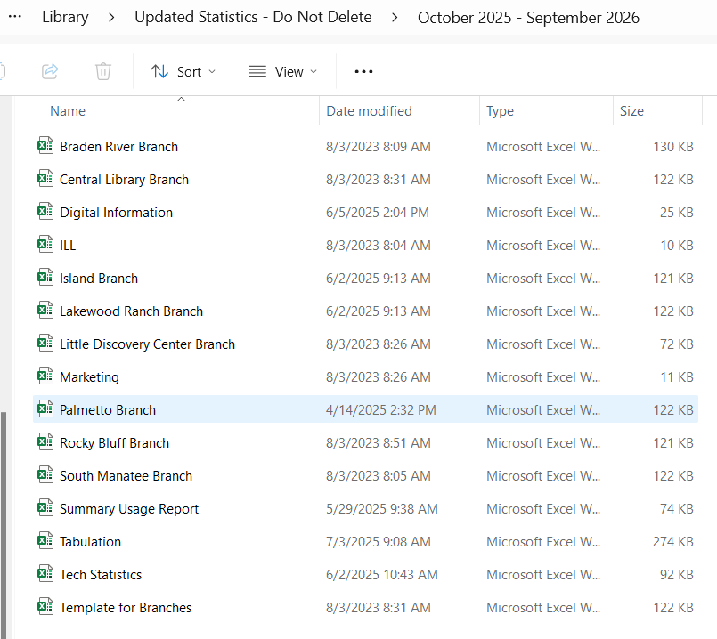
How to add new Fiscal Years?
Open the new folder and start adding your statistics for the new Fiscal Year

Slide 8
How to add new Fiscal Years?

Slide 9
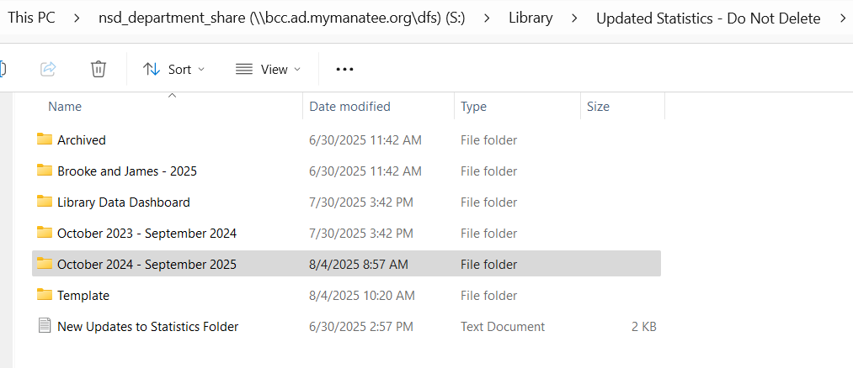
How to add a new Library Branch?
Open the Current Fiscal Year’s Folder

Slide 10
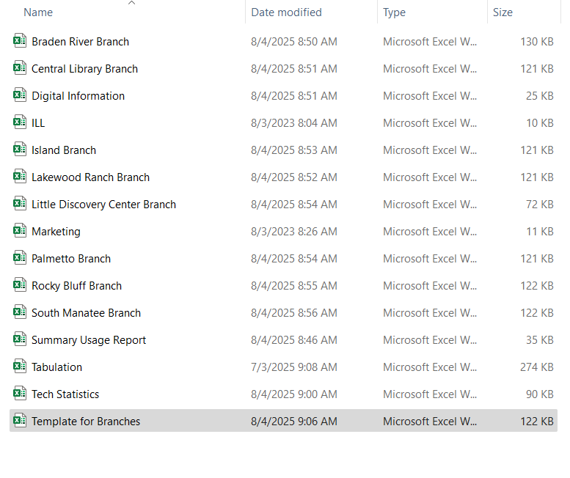
How to add a new Library Branch?
Select and Copy (Ctrl+C) the “Template for Branches.xlsx”

Slide 11
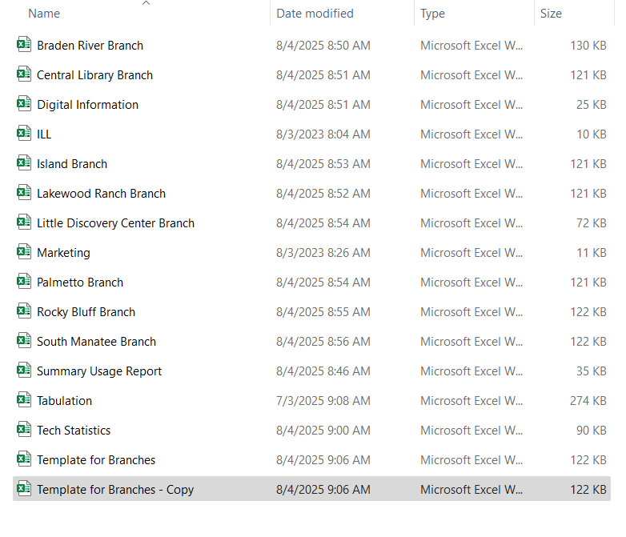
How to add a new Library Branch?
Paste (Ctrl+V) the “Template for Branches.xlsx”

Slide 12
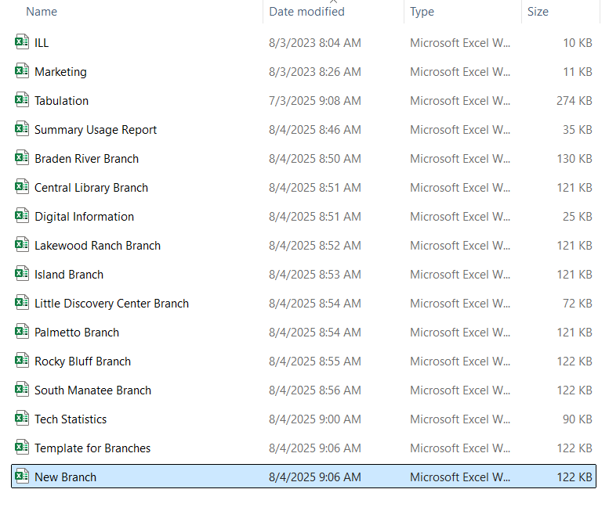
How to add a new Library Branch?
Rename Excel file to “___________ Branch.xlsx”

Slide 13
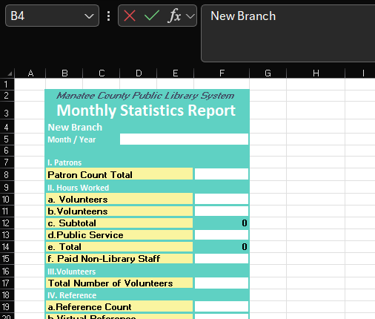
How to add a new Library Branch?
Open the new Branch Excel file and change Cell B4 to the name of the new branch

Slide 14
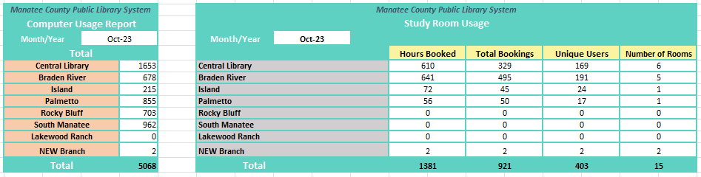
How to add a new Library Branch?
Open the “Summary Usage Report.xlsx” file and add rows for the new Branch

Slide 15
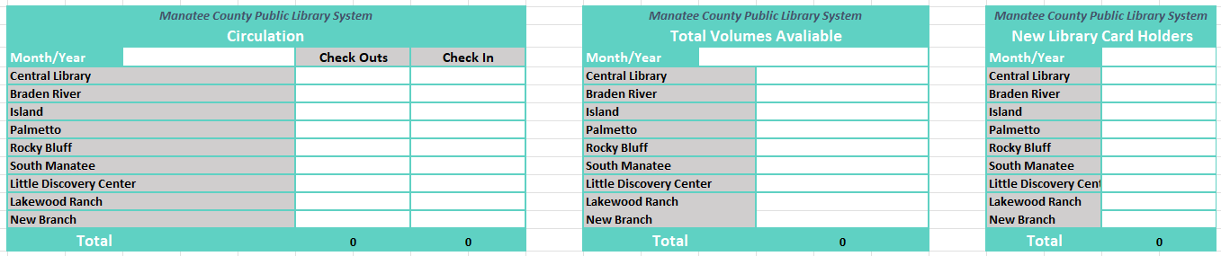
How to add a new Library Branch?
Open the “Tech Statistics.xlsx” and add rows for the new Branch

Slide 16
How to Grant Access to View the Dashboard?

Slide 17
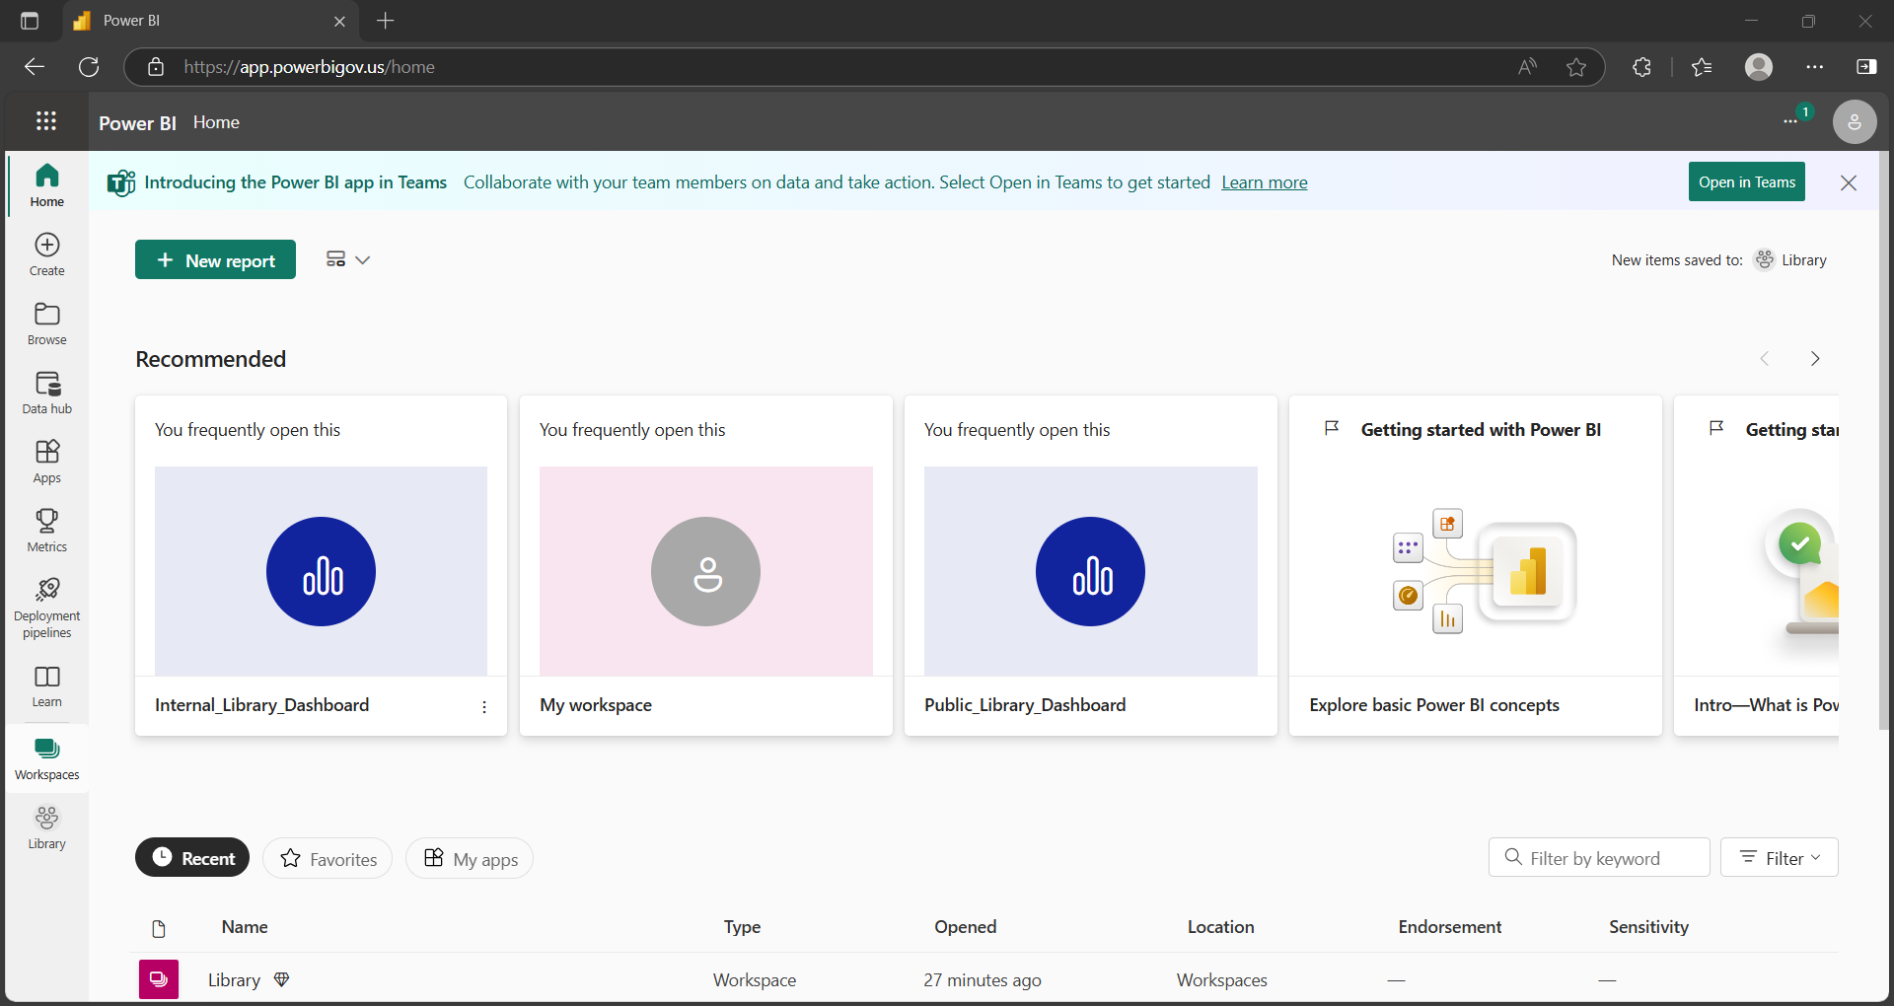
How to Grant Access to View the Dashboard?
Go to Power BI Home and select the “Workspaces” Tab

Slide 18
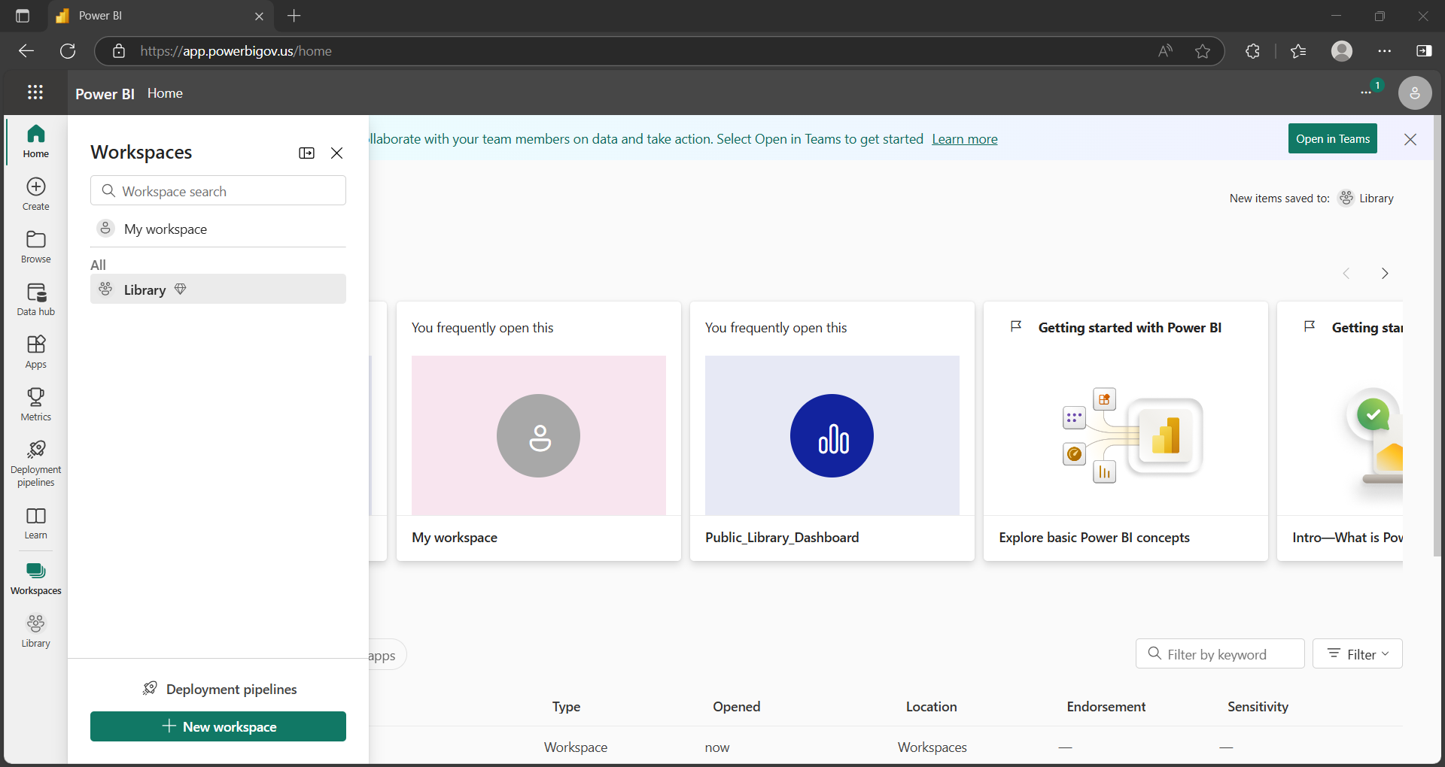
How to Grant Access to View the Dashboard?
Select the “Library” Workspace

Slide 19
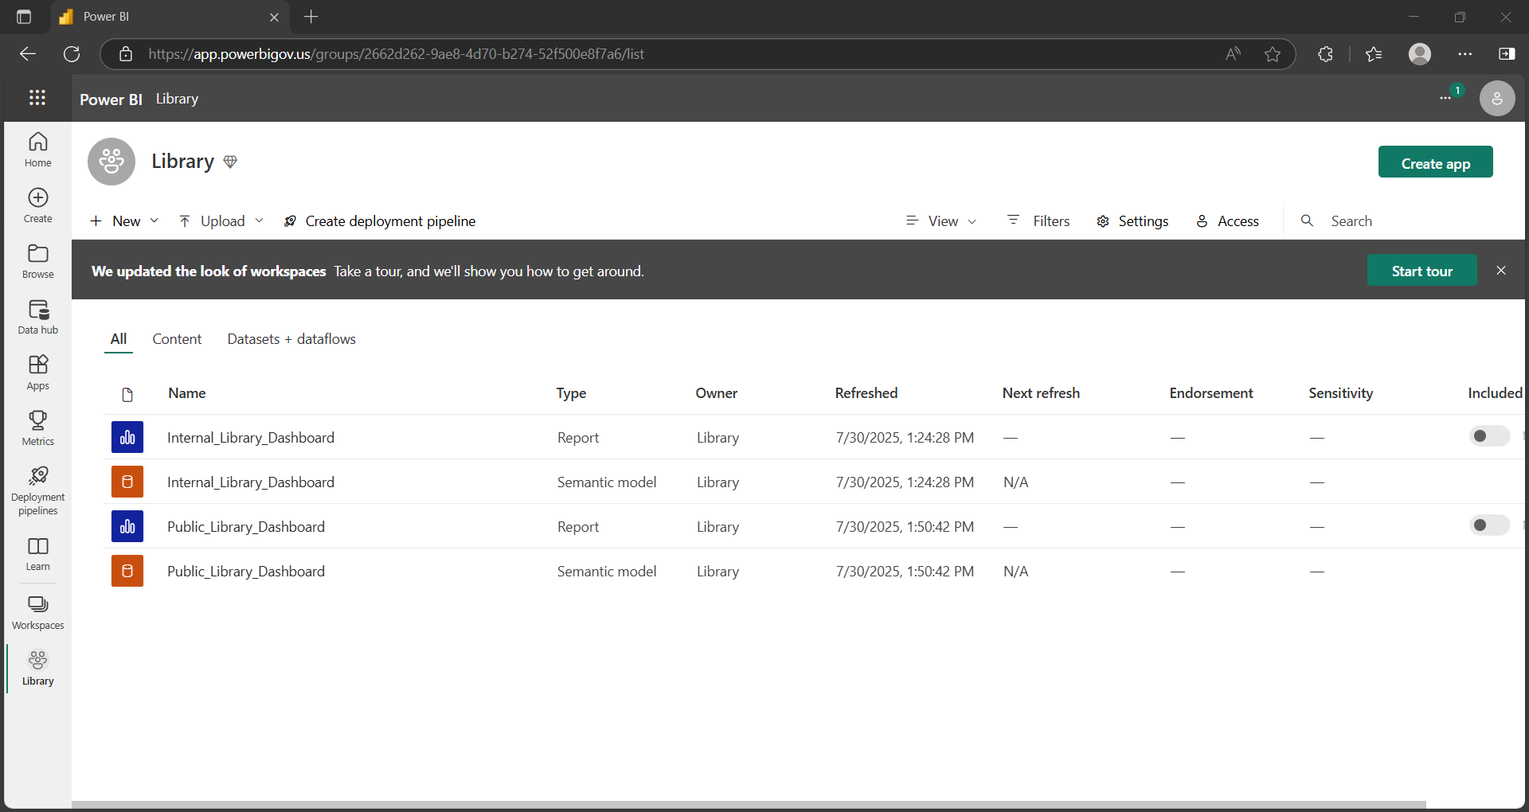
How to Grant Access to View the Dashboard?
Select the “Access” Button

Slide 20
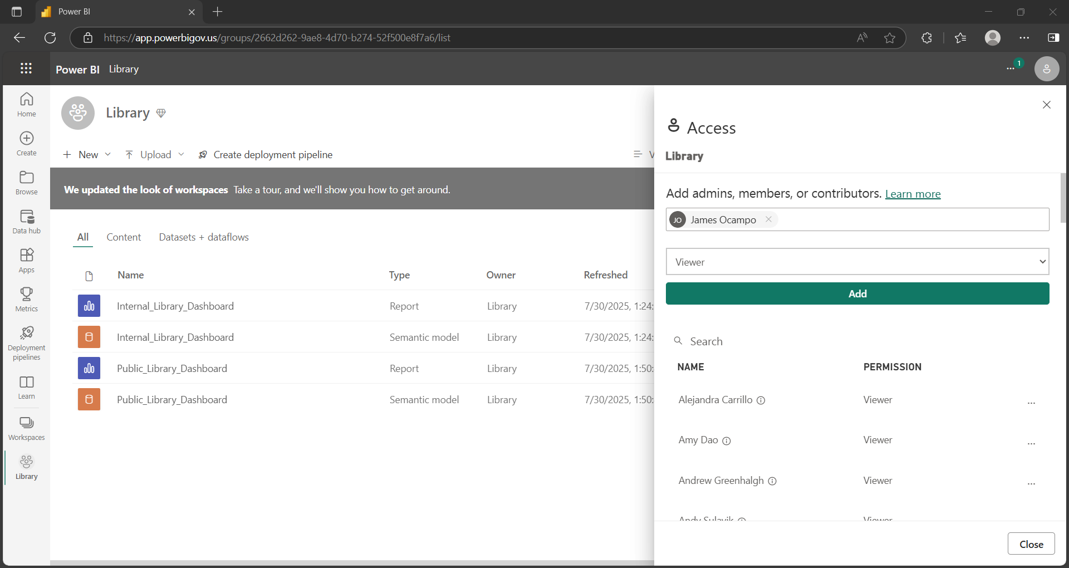
How to Grant Access to View the Dashboard?
Select the “Access” Button

Slide 21
How to Manually Update the Dashboard?

Slide 22
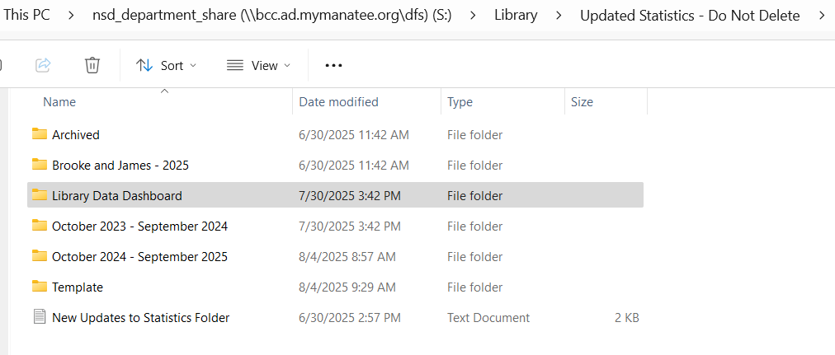
How to Manually Update the Dashboard?
Open the “Library Data Dashboard” Folder

Slide 23
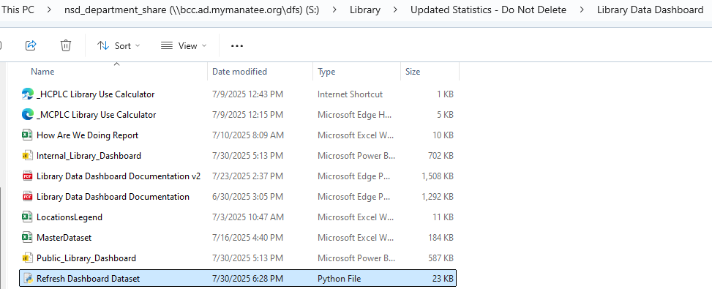
How to Manually Update the Dashboard?
Double-Click on the “Refresh Dashboard Dataset.py” file to run it

Slide 24
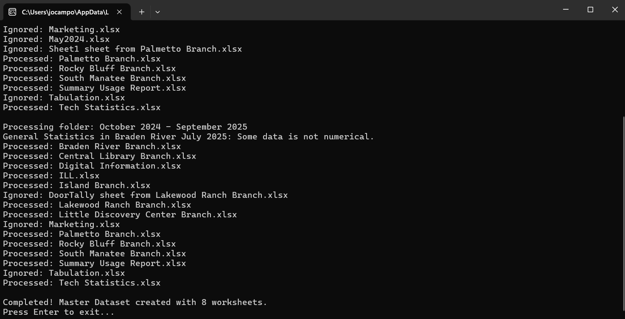
How to Manually Update the Dashboard?
Press the ‘Enter’ key on your keyboard once it is Completed to close the Program

Slide 25
How to Manually Update the Dashboard?
Go to Power BI Home and select the “Workspaces” Tab

Slide 26
How to Manually Update the Dashboard?
Select the “Library” Workspace

Slide 27
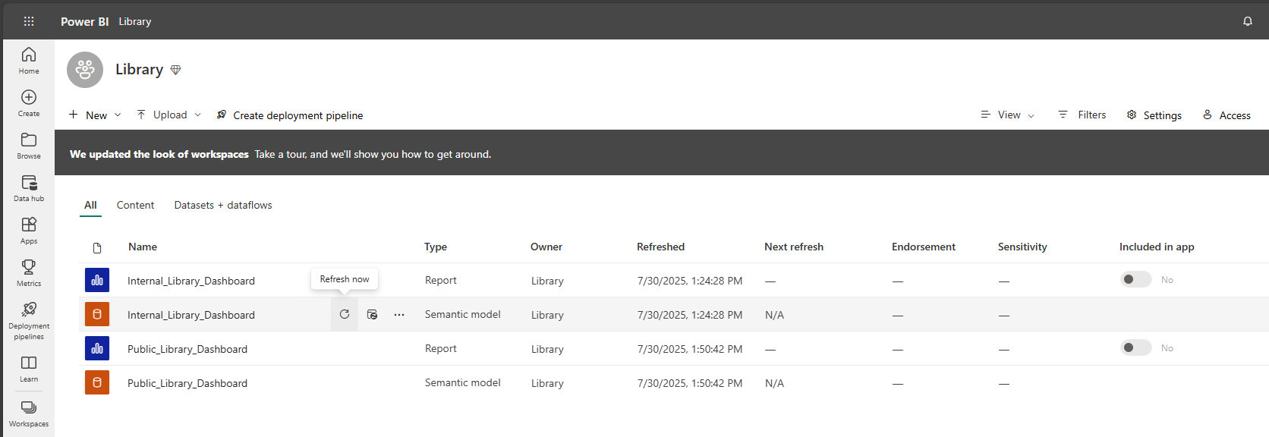
How to Manually Update the Dashboard?
Hover over the Dashboard you want to update and click the “Refresh Now” Button.

Slide 28
Limitations

Slide 29

Limitations
DO NOT rearrange the Tables in the Excel Files of the Statistics Folder
The Program used to Extract the Data ( ) associates specific cells with a specific metric.
Ex: Cell ‘B4’ in refers to the name of the Library Branch for Branch Reports.
Rearranging any Table will cause the Program to fetch the data inaccurately. But, additions to empty spaces is okay.

Slide 30
Limitations
Adding NEW metrics to the Data Dashboard requires changes to the Python Program.
The Program used to Extract the Data ( ) associates specific cells with a specific metric.
If a new metric is added to the Statistics Folder like “Total On-Time Book Returns” and you want it to be added to the Dashboard you must carefully code the program to:
Find the Cell(s) where your Metric is stored.
Add the Metric as a column to the ‘MasterDataset.xlsx’ file.
Manually update the Dashboard to include these changes.

